Slide 1
Database Design Install & Populate
Hunter Bartlett
ISIN 325: Database Security

Slide 2
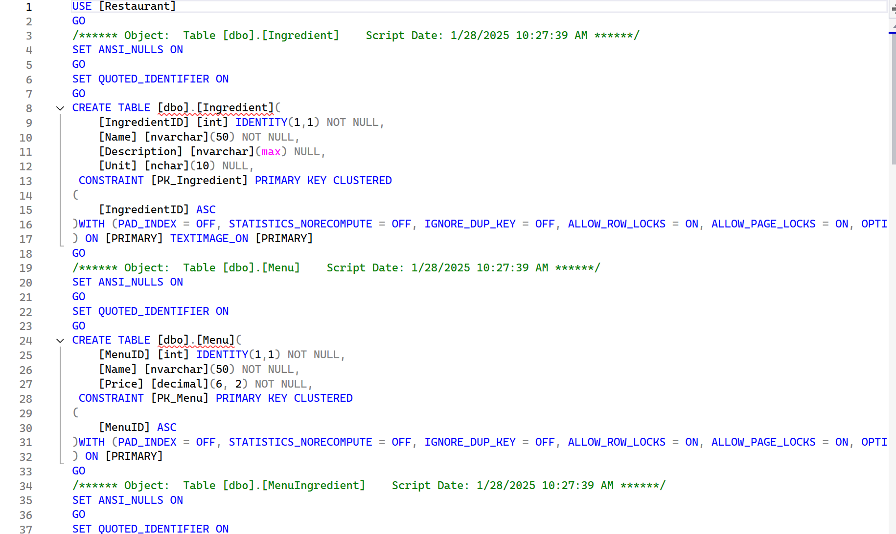
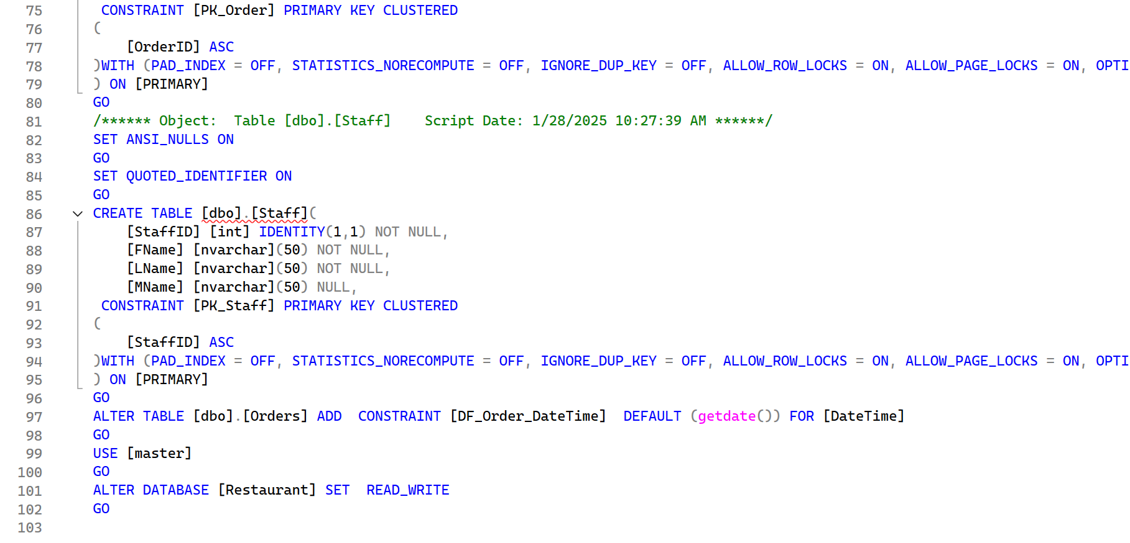
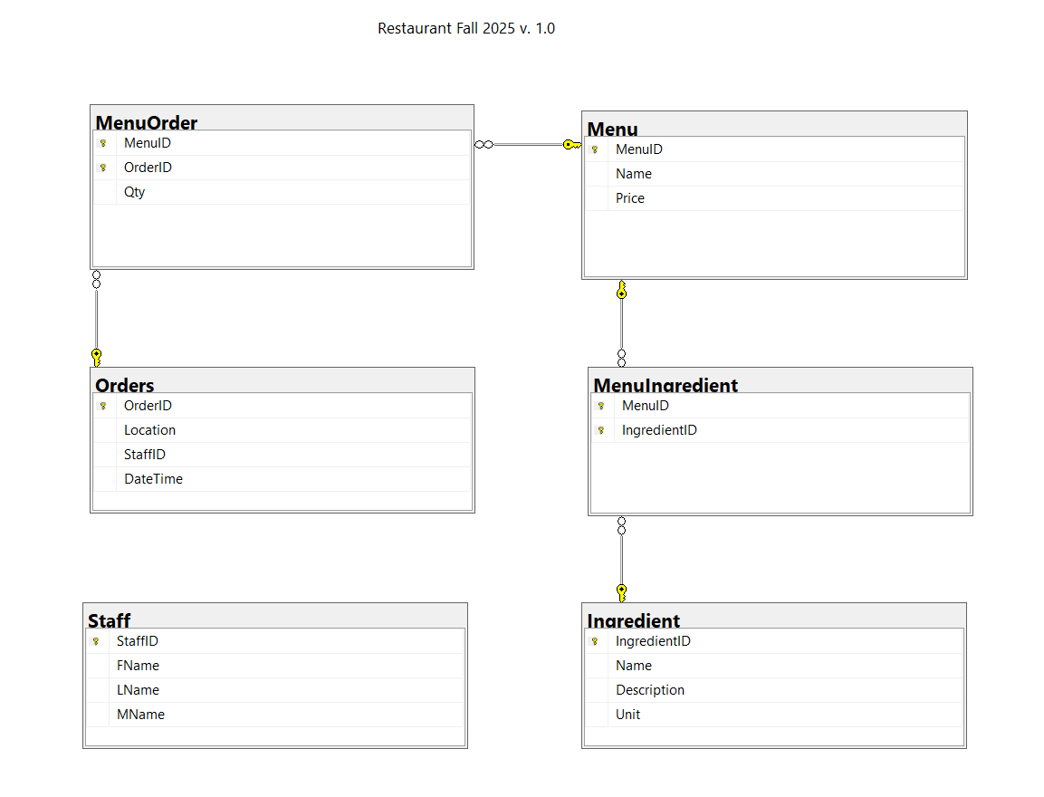
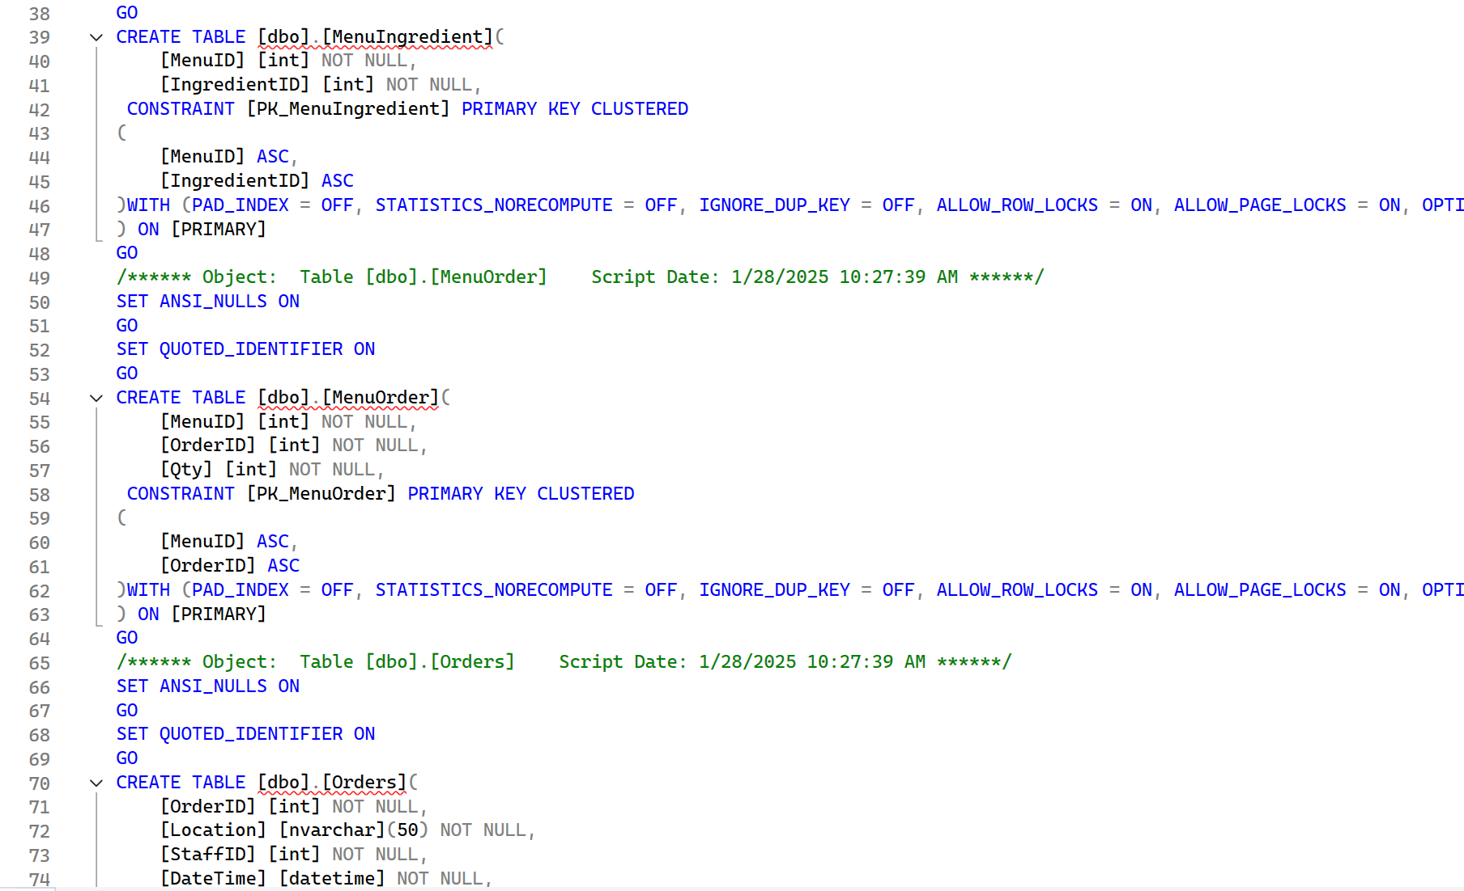

Slide 3
Install
The database install process was quite simple. I created my database in the express server on my machine and named it “Restaurant”. Next I used the script outlined in class to be able to create all of the tables, and the fields that would be in the tables. I did not run into any issues when installing the tables into the database.

Slide 4
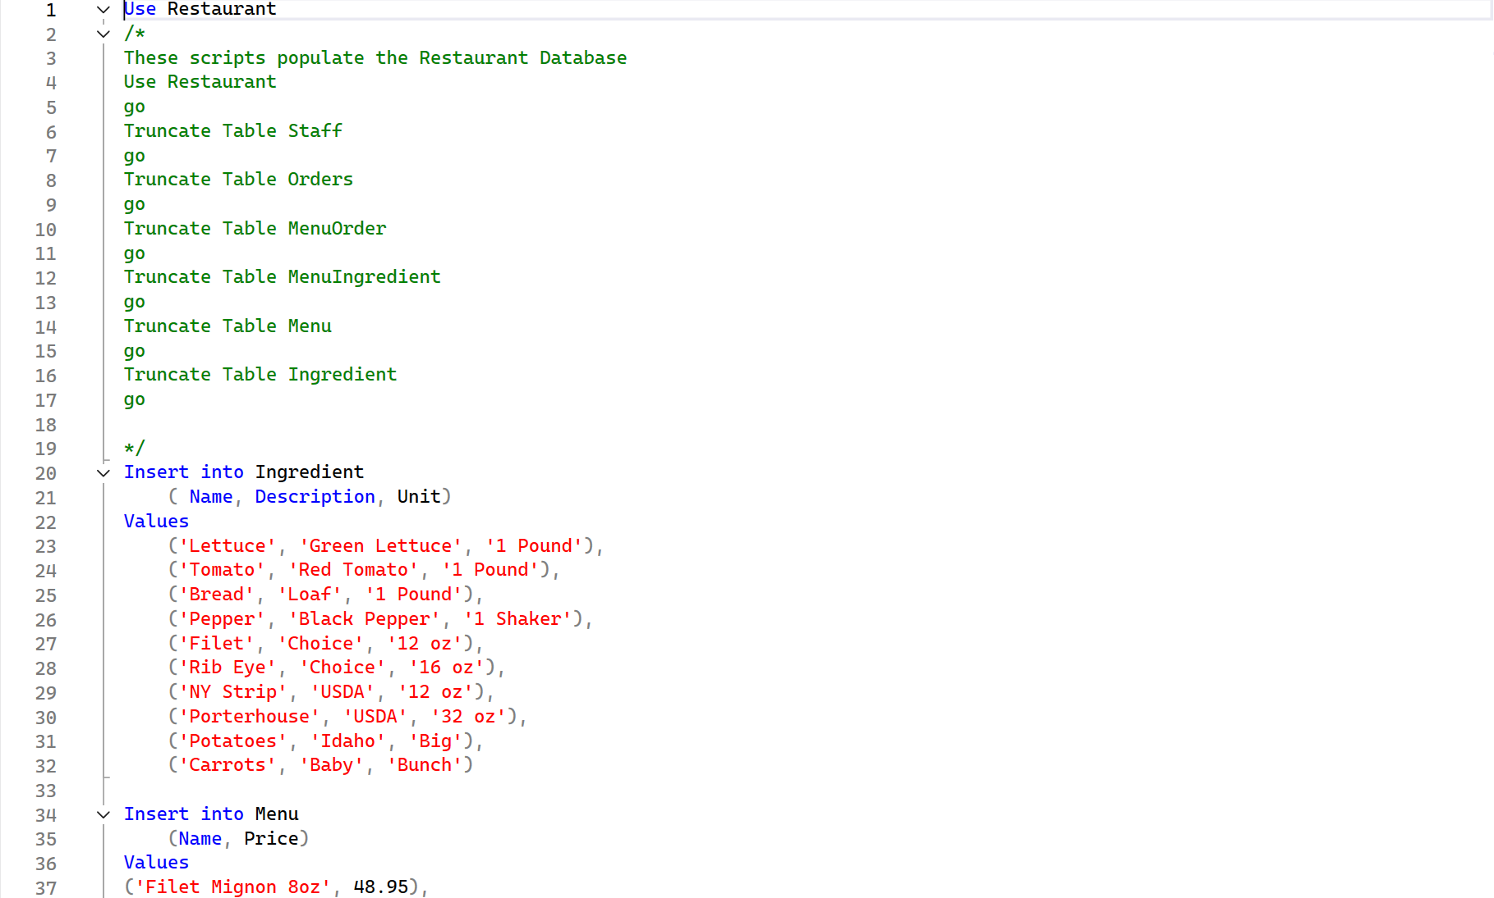
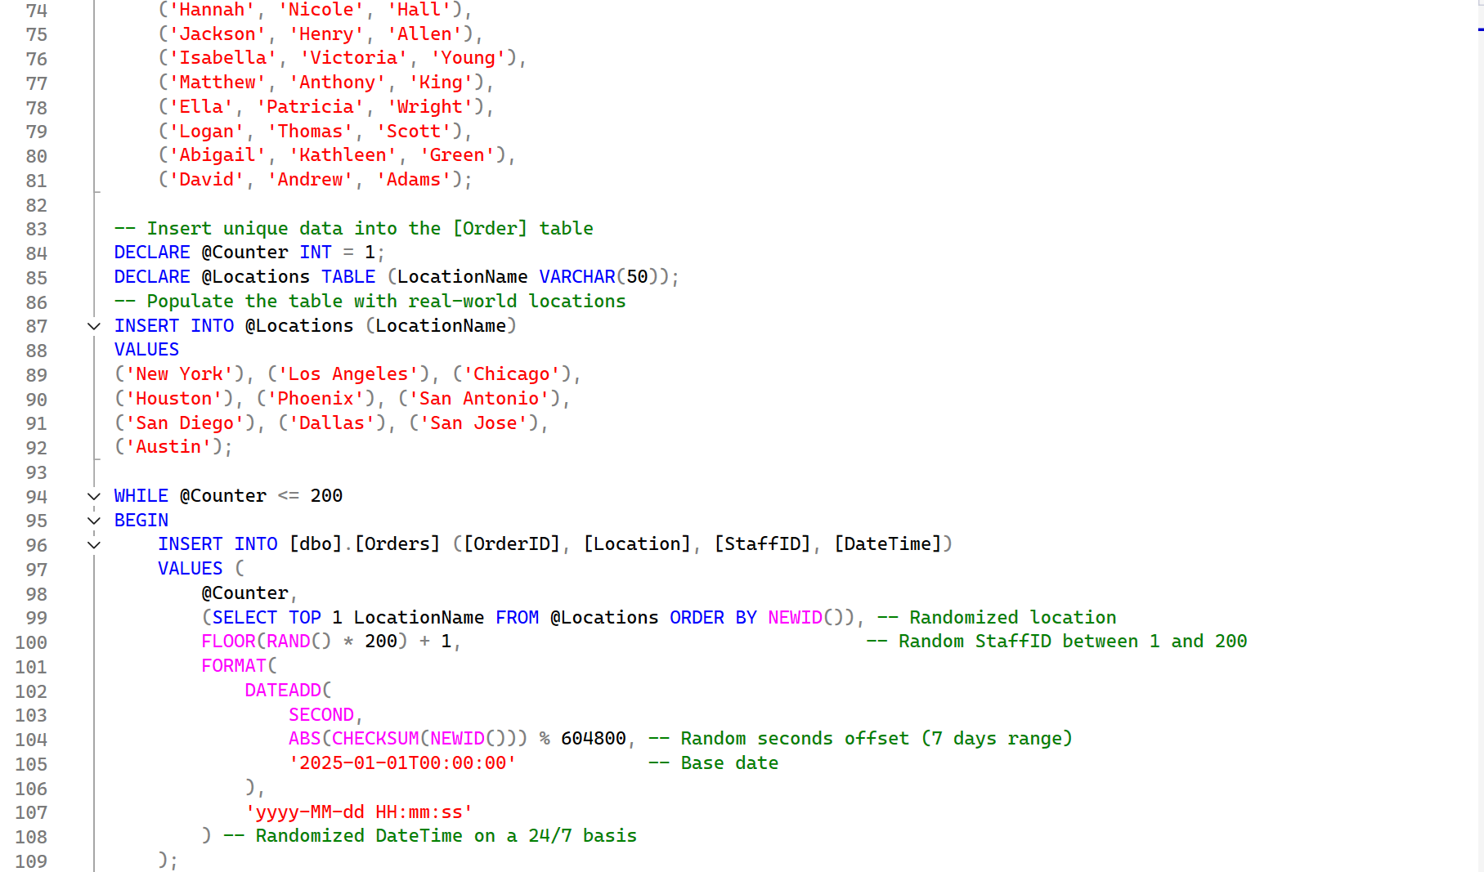
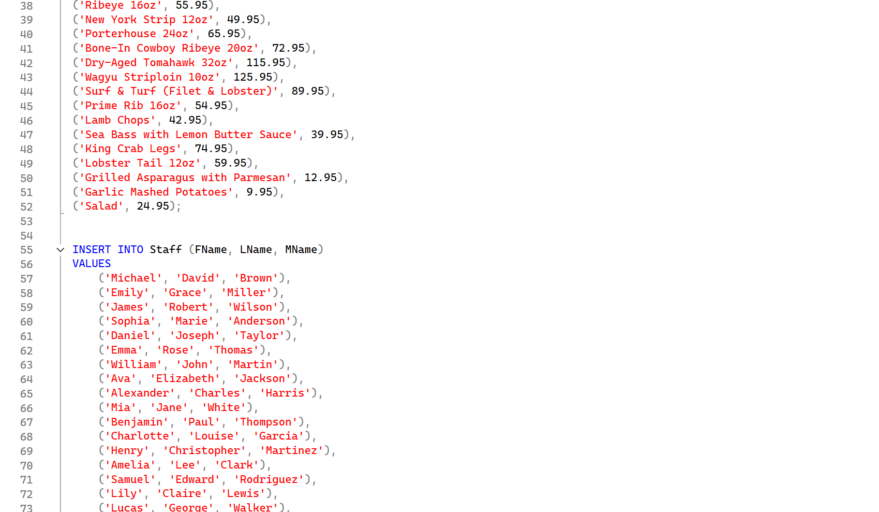
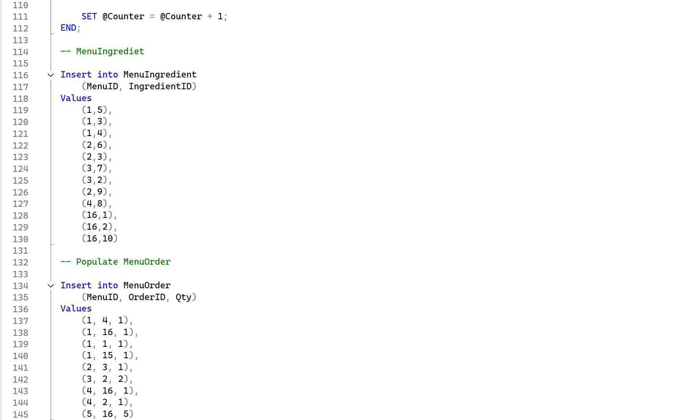

Slide 5
Populate
Using insert into, and values commands I was able to populate the tables into SQL server. For example the ingredient table had many different rows including lettuce, tomatoes, and potatoes. All of these included the name, description, and size. Sizes were different for most ingredients, the lettuce used pounds but the potatoes used Big.

Slide 6
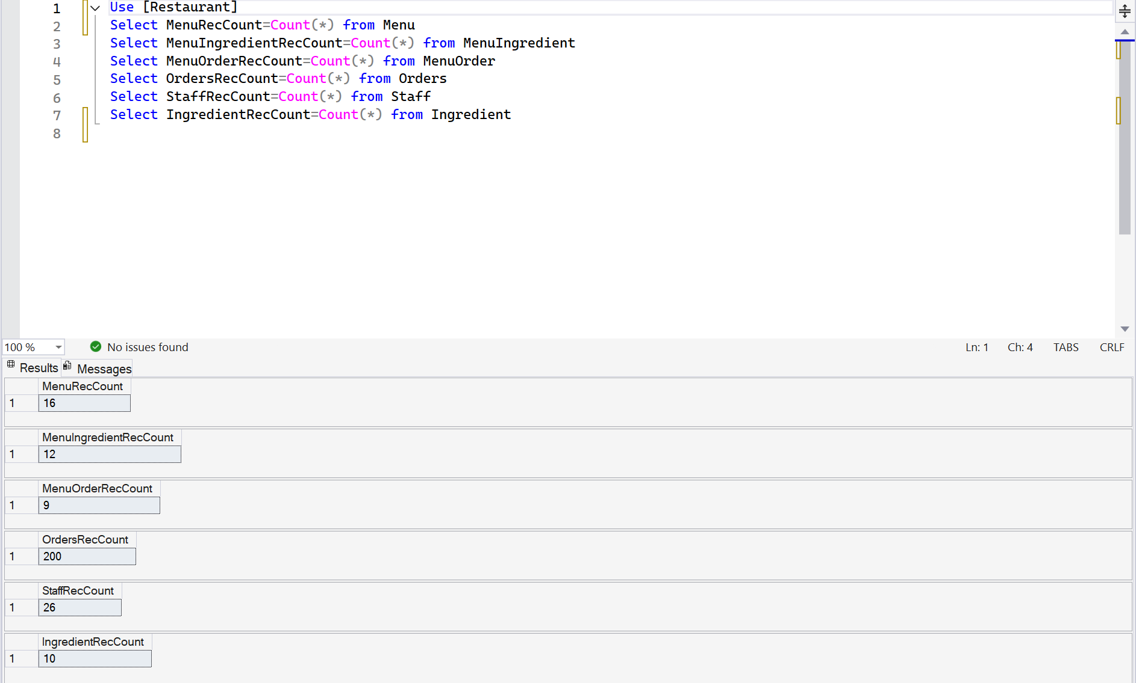
Rec Count
The record count command included the select and count from functions. All of these used the “*” which endured that all the records were counted. All the counts were also named according to which table it was counting from.

Slide 7
Challenges & Learning
I did not run into any challenges with the install or populate scripts, however I did run into a small problem with the Rec Count script which at first did not know which database to pull the data from. I had to modify the first line to “Use [Restaurant]” for the script to know which database to pull the data from.
There were many things that I learned from this assignment including how to run scripts and what functions each of the commands do. Another thing that I learned was how to organize scripts for the future in order to get proper tables and data into the tables.

